Slide 1
Module 4 — Submission & Ingest
Digital Preservation Workflow Curriculum
Digital Preservation Network (DPN)
Notes:
Final: March 8, 2017
This work is licensed under the Creative Commons Attribution 4.0 International License. To view a copy of this license, visit http://creativecommons.org/licenses/by/4.0/ or send a letter to Creative Commons, PO Box 1866, Mountain View, CA 94042, USA.
Please reference the Digital Preservation Network (DPN) http://www.dpn.org when using this work.

Slide 2
Planning
Selection
Preparation
Submission
Post-Submission
Sustainability

Slide 3
Module Goals
Upon completion of this module, participants should be able to:
Understand best practices for the ingest of submission information packages (SIPs) to a preservation environment (either locally hosted, in the cloud, or through a preservation service)
Understand the information required to capture submission events to maintain auditable logs
Gain experience ingesting submission packages to preservation environments through hands-on exercises

Slide 4
Lesson 1: Submission & Ingest

Slide 5
First: Define the terms
SIPs (brief review)
Ingest
Preservation environments
Module 4 — Submission & Ingest / Lesson 1 — Submission & Ingest
Notes:
If Module 4 is being taught on its own, replace this slide with slides 1-13 from Module 3: Lesson 1.

Slide 6
OAIS Information model
INGEST
SIP
AIP
DIP
PRESERVATION
ENVIRONMENT
Module 4 — Submission & Ingest / Lesson 1 — Submission & Ingest
Notes:
This is similar to a slide from Module 3, used here as a reminder about the relationship between SIPs, AIPs, and DIPs. If Module 3 is not being presented alongside this one, start this section with the overview of the OAIS model in Module 3.
Reminder that for the purposes of this workshop, we are focusing on SIPs prepared by an organization and submitted to an internal or external preservation service.

Slide 7
What is a SIP? (Review)
A SIP is the package of data that is delivered to a preservation environment. It contains the content to be preserved, including the data objects & metadata.
SIPs can be assembled from many sources (e.g., content creators, digitization vendors, collection managers).
SIPs can be created at many different levels of granularity (e.g., file level, intellectual entity level, collection level).
SIPs may be physical or logical.
Module 4 — Submission & Ingest / Lesson 1 — Submission & Ingest
Notes:
If Module 4 is being taught on its own, replace this slide with slides 1-13 from Module 3: Lesson 1.

Slide 8
What is an AIP?
An AIP is the package of data that is stored in a preservation environment. It contains the content that is preserved, including the data objects, metadata, and preservation description information (PDI).
AIPs are produced during ingest (from SIPs) and can contain information about preservation events that occur during the ingest process and after, and store it as PDI.
The granularity of an AIP (e.g., file level, intellectual entity level, collection level) may be dependent on the SIP structure from which it is derived.
Notes:
Terms referenced in this slide and previous (including SIP, AIP, and PDI) are taken from the OAIS standard. See: https://public.ccsds.org/pubs/650x0m2.pdf

Slide 9
What happens during ingest?
Ingest, in the OAIS model, is the process that:
Accepts a file (or files) and all related metadata (SIP)
Verifies the file (or files)
Extracts the relevant data to create the AIP
Prepares the AIP for storage
Ensures that AIPs and their supporting Descriptive Information become established within the preservation environment
Module 4 — Submission & Ingest / Lesson 1 — Submission & Ingest
Notes:
SIP = Submission Information Package
AIP = Archival Information Package
Slide information taken from “6.2.1 Submission Information Package (SIP).” Guidelines on the Production and Preservation of Digital Audio Objects (web edition), International Association of Sound and Audiovisual Archives. http://www.iasa-web.org/tc04/submission-information-package-sip

Slide 10
What defines a preservation environment?
Active — storage is on a network, in the cloud, or through a collaborative service
Managed — at a minimum, files are actively monitored for integrity and attendance, and those actions are logged and available for collection managers
Resourced — the infrastructure is funded, staffed, and governed to ensure its longevity
Secure — appropriate security protocols are applied to ensure the safety of the AIPs stored in it
Future proof — infrastructure is monitored and maintained to withstand obsolescence and degradation
Module 4 — Submission & Ingest / Lesson 1 — Submission & Ingest

Slide 11
Preservation events
Ingest events are one-time preservation events that can be captured, logged, and used to audit or monitor the fixity of an AIP once it is in the preservation environment.
Ongoing or recurring events occur in the preservation environment. These may include monitoring (such as fixity or format validation), access, or migration activities.
If preservation events are recorded from the point of submission (or earlier) and over time—and those events are auditable—a file’s fixity (or integrity) can be validated.
Module 4 — Submission & Ingest / Lesson 1 — Submission & Ingest

Slide 12
Types of ingest events
Ingest can involve a variety of events or processes that are enacted upon a SIP. The following are a few of those events:
Check for viruses
Validate packages
Validate file formats
Move files
Calculate checksums
Check for fixity
File characterization
Assign unique IDs
Normalize filenames
Normalize file formats
Create AIPs
Create derivatives
Module 4 — Submission & Ingest / Lesson 1 — Submission & Ingest

Slide 13
Ingest events: Check for viruses
Ensuring that files moving into a preservation environment are not infected with viruses is core to the ingest process.
If a file is found to be infected, it will typically be rejected and quarantined locally for virus removal.
Module 4 — Submission & Ingest / Lesson 1 — Submission & Ingest

Slide 14
Ingest events: Validate submission packages
To ensure that a SIP conforms to the rules established by an organization, it is validated against those rules before it is ingested into the preservation environment.
For example, a rule might confirm that all core information (e.g., data file, metadata, manifest) is found in the SIP. If missing, the SIP might be rejected from ingest.
Module 4 — Submission & Ingest / Lesson 1 — Submission & Ingest

Slide 15
Ingest events: Validate file formats
To ensure that a file is the format it purports to be, a file validation tool can be run against a SIP.
DROID is one tool that identifies the precise format of a file, and links that identification to a central registry of technical information about that format and its dependencies.
Module 4 — Submission & Ingest / Lesson 1 — Submission & Ingest

Slide 16
Ingest events: Move files
Through the ingest process, SIPs will be transformed into AIPs and those packages will be moved to a new storage location, ideally in a preservation environment.
Module 4 — Submission & Ingest / Lesson 1 — Submission & Ingest

Slide 17
Ingest events: Calculate checksums
This process uses an algorithm (e.g., SHA-256 or MD5) to calculate a string of numbers (called a “hash” or “checksum”) that represents a file. If the file changes, the checksum changes.
Using checksums, a system can test for duplication on ingest, and monitor file fixity (the file remains unchanged) and attendance (the file has not been moved or deleted) throughout its life in the preservation environment.
Module 4 — Submission & Ingest / Lesson 1 — Submission & Ingest

Slide 18
Ingest events: Check for fixity
When a file arrives at the ingest process with a checksum, the ingest system does not have to produce one. Instead, it will test against the existing checksum once the file has been ingested.
Module 4 — Submission & Ingest / Lesson 1 — Submission & Ingest

Slide 19
Ingest events: File characterization
The process of extracting technical metadata associated a file.
Technical metadata is important for understanding the structure of the file, how to manage it, and to enable monitoring it for obsolescence.
Module 4 — Submission & Ingest / Lesson 1 — Submission & Ingest

Slide 20
Ingest events: Assign unique IDs
To ensure that AIPs and the individual files that make them up are identified uniquely, new IDs may be assigned on ingest.
These IDs should not be associated with another naming or organizing scheme. Instead they should be unique to the preservation environment.
Module 4 — Submission & Ingest / Lesson 1 — Submission & Ingest

Slide 21
Ingest events: Normalize filenames
To ensure that files are not overwritten in the preservation environment, they may be given unique filenames upon ingest.
If changes are made to filenames, the original filenames should be maintained in the metadata.
Additionally, file suffixes may be normalized for easier management and uniformity (e.g., tif instead of TIFF).
Module 4 — Submission & Ingest / Lesson 1 — Submission & Ingest

Slide 22
Ingest events: Normalize file formats
Some preservation environments have a limited set of file types they will accept—typically these are widely recognized preservation formats. On ingest, files may be converted to one of these preservation formats.
Module 4 — Submission & Ingest / Lesson 1 — Submission & Ingest
Notes:
See this list of file formats from the National Archives for an example of preferred digital formats: https://www.archives.gov/records-mgmt/policy/transfer-guidance-tables.html

Slide 23
Ingest events: Create AIPs
Ultimately, through the ingest process, an AIP is created, which is stored and managed in the preservation environment for as long as needed.
Module 4 — Submission & Ingest / Lesson 1 — Submission & Ingest

Slide 24
Ingest events: Create derivatives
In some cases, derivative files, or proxies, are created so the content of an AIP can be accessed or viewed more easily. Derivative files are typically smaller in size and lower in quality than the primary formats being preserved.
The derivatives may or may not receive the same preservation treatment as the primary, or master, files.
Module 4 — Submission & Ingest / Lesson 1 — Submission & Ingest

Slide 25
Automating ingest
The more automated, the more likely it is that an ingest process will be performed.
Most automated: Integrated preservation environments — may perform all or most ingest events (e.g., Archivematica + storage service)
Some automation: Front-end transfer/archive systems — may perform some ingest tasks (e.g., Exactly, CLI applications)
Least automated: Manual transfer — may perform 1 to ? tasks
Module 4 — Submission & Ingest / Lesson 1 — Submission & Ingest

Slide 26
Automating ingest
Remember: Decide what is good enough right now and do it.
Module 4 — Submission & Ingest / Lesson 1 — Submission & Ingest

Slide 27
Lesson 2: Documenting Ingest

Slide 28
Documenting ingest: Why?
For system transparency
So more than one person knows what is going on
To ensure that requirements are being met
To store for future reference, as part of the audit trail
Module 4 — Submission & Ingest / Lesson 2 — Documenting Ingest

Slide 29
What event information should be captured?
One-time events (e.g., characterization, creating checksums, virus check)
Ongoing events (e.g., fixity and obsolescence monitoring)
One-time actions (e.g., rename, move, download/access)
Module 4 — Submission & Ingest / Lesson 2 — Documenting Ingest

Slide 30
How should event information be documented?
Systems like Archivematica capture this information during the submission process.
Preservation storage environments can capture events, as well.
Some organizations may need to rely on manual documentation as they perform these tasks.
When this is the case, information may be minimal
Remember: do what is possible right now (and plan for improvements in the future)
Module 4 — Submission & Ingest / Lesson 2 — Documenting Ingest

Slide 31
PREMIS Data Dictionary
PREservation Metadata: Implementation Strategies
Defines a core set of semantic units that repositories should know in order to perform their preservation functions.
Provides a data structure for documenting changes to digital assets.
Module 4 — Submission & Ingest / Lesson 2 — Documenting Ingest

Slide 32
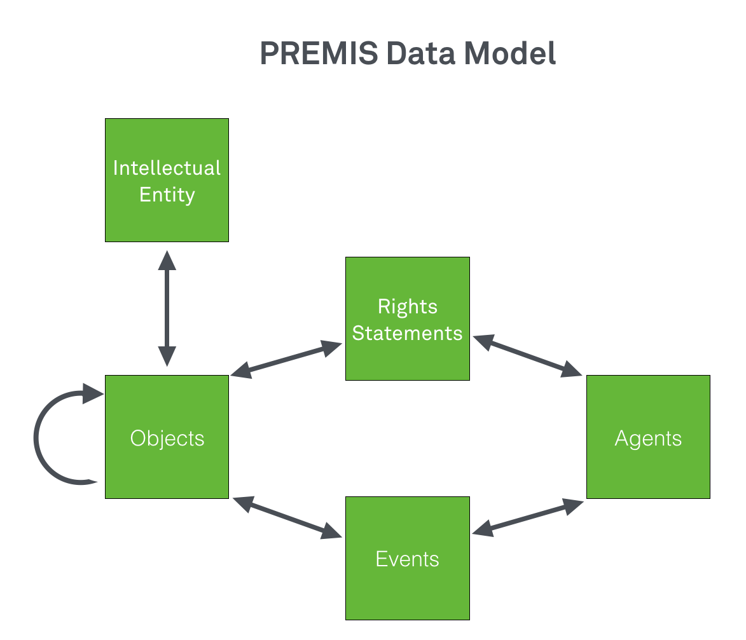
Module 4 — Submission & Ingest / Lesson 2 — Documenting Ingest

Slide 33
PREMIS Data Model
Object entities are at the core of the data model, with other entities associated with them.
An Object entity defines a digital file (e.g., TIF, PDF, MP4).
Agents, Events, and Rights entities aggregate information about the Object.
Intellectual entities are conceptual and define "a set of content that is considered a single intellectual unit for purposes of management and description.” (e.g., a book, map, photograph, or video)
Module 4 — Submission & Ingest / Lesson 2 — Documenting Ingest

Slide 34
PREMIS Data Model: Events
Events entities contain information about actions that affect an Object, such as those described earlier in this presentation.
Module 4 — Submission & Ingest / Lesson 2 — Documenting Ingest

Slide 35
PREMIS Data Model: Events
The information that can be recorded about events includes:
a unique identifier for the event (type and value)
the type of event (creation, ingestion, migration, etc.)
the date and time the event occurred
a detailed description of the event
a coded outcome of the event
a more detailed description of the outcome
agents involved in the event and their roles
objects involved in the event and their roles
Module 4 — Submission & Ingest / Lesson 2 — Documenting Ingest

Slide 36
Documenting event information with PREMIS
Many preservation systems use the PREMIS Events entity metadata fields (called “semantic units” in PREMIS) to capture and document preservation events.
Even when tracking this information manually, using a standard like PREMIS makes transitioning to future systems easier.
Module 4 — Submission & Ingest / Lesson 2 — Documenting Ingest

Slide 37
Sample PREMIS Event metadata
<event>
<eventIdentifier>
<eventIdentifierType>LocalRepository</eventIdentifierType>
<eventIdentifierValue>E001.3</eventIdentifierValue>
</eventIdentifier>
<eventType>validation</eventType>
<eventDateTime>2006-06-06T00:00:00.005</eventDateTime>
<eventDetail>jhove1_1e</eventDetail>
<eventOutcomeInformation>
<eventOutcome>successful</eventOutcome>
<eventOutcomeDetail>
<eventOutcomeDetailNote>Well-formed and valid</eventOutcomeDetailNote>
</eventOutcomeDetail>
</eventOutcomeInformation>
<linkingAgentIdentifier>
<linkingAgentIdentifierType>AgentID</linkingAgentIdentifierType>
<linkingAgentIdentifierValue>na12345</linkingAgentIdentifierValue>
</linkingAgentIdentifier>
<linkingObjectIdentifier>
<linkingObjectIdentifierType>hdl</linkingObjectIdentifierType>
<linkingObjectIdentifierValue>loc.music/gottlieb.09602</linkingObjectIdentifierValue>
</linkingObjectIdentifier>
</event>
Module 4 — Submission & Ingest / Lesson 2 — Documenting Ingest
Notes:
From: https://www.loc.gov/standards/premis/louis-2-1.xml

Slide 38
Exercise: Tracking Events in an Inventory
Type: Discussion
Goal: Understand basic event tracking and the value of maintaining an up-to-date inventory
Description: Documenting collections with an inventory was introduced in Module 2. Because the inventory is a living document, it should reflect the current status of collections with appropriate event information. Participants will discuss what events to document in various settings (e.g., robust preservation environment or limited infrastructure).
In a best-case scenario, what ingest/submission events/information would be tracked?
For a manually managed system, what are the key pieces of ingest/submission information most necessary to track collections?
What happens if an inventory isn’t kept up to date?
What are some strategies for ensuring that inventories remain up to date?
Module 4 — Submission & Ingest / Lesson 2 — Documenting Ingest

Slide 39
Lesson 3: Ingest Exercise

Slide 40
Exercise: Ingesting Files into a Preservation System
Type: Demonstration or Hands-on
Goal: Understand how preservation systems ingest content, how they work with transfer tools (like Exactly), and see what documentation the ingest process outputs.
Description: Instructor will demonstrate the ingest process for a preservation system (such as DPN, DuraCloud, APTrust, etc.). Group will discuss experiences between this tool and Exactly exercise in Module 3 (e.g., what does each tool accomplish, how are they different/same, can they be combined into a single workflow, how can these tools help to develop a systematized digital preservation program?)
Module 4 — Submission & Ingest / Lesson 3 — Ingest Exercises

Slide 41
Lesson 4: Creating a Program

Slide 42
Exercise: Ingest as Part of the Larger Workflow
Type: Group Discussion
Goal: Understand the role ingest plays in the preservation program continuum.
Description: Participants will identify the decision points to create a programmatic approach to the submission of content into a preservation environment. For example:
What resources are required? And, who is responsible?
How will submission event information be tracked over time?
What is required on an ongoing basis in order for submission to become systematic and sustainable?
What resources would help?
Tools, Skills, etc.
Module 4 — Submission & Ingest / Lesson 4 — Creating a Program

